Slide 1
OQC DIGITAL SYSTEM
Analysis of OQC System Functional Diagram
Make Planning
SCM
Send file inventory & shipment plan
FA
Compare Stock base on file plan and update
OQC
Send daily production plan
Step 1
OQC
Filter priority shipmen models to inspection
Input daily production to excel file
Pick up sample to Inspection
Based on the production plan file of SCM
Based on sample standard file
Pick up samples based on weight check system results
Step 2
OQC
Scan barcode outer serial
Scan all barcodes inner serial
Confirm S/N Outer & all inner boxes

Slide 2
OQC DIGITAL SYSTEM
Analysis of OQC System Functional Diagram
Step 3
OQC
Weight check 1st
Product weight control
Step 4
Normal inspection
Appearance inspection, function, WI
OQC
OQC
inspection
Reliability inspection
Characteristic, Vibration, Drop, Temperature test
Step 5
OQC
Scan barcode inner product
Based on the mater list

Slide 3
OQC DIGITAL SYSTEM
Analysis of OQC System Functional Diagram
Step 6
OQC
Weight check 2nd
Product weight control
Step 7
OQC
Scan barcode outer serial
Scan all barcodes inner serial
Confirm S/N Outer & all inner boxes
Step 8
OQC
Return sample
Judgment all Lot

Slide 4
OQC DIGITAL SYSTEM
Chop stamp process of OQC
Packing FA
FA shrink Pallet ID
ID Pallet Station
FA warehouse
SCM warehouse
Case 1
NO ID Pallet
Case 2
ID Pallet issue in FA process
OQC get sample
None Pallet
Chop stamp physical, record by excel file
OQC get sample
Return sample
Find all pallet same model, production date, line, shift
OQC Inspection
NG
OQC Inspection
OK
NG
OK
return sample
Maching ID Pallet and Outer carton before return
Find & Return correct Pallet ID taken
Notify NG error for FA

Slide 5
OQC DIGITAL SYSTEM
Rule to Judge 1 LOT
Define 1 lot:
When a model runs, another model inserted will be counted as 1 lot. (Lot: when a new model is inserted or finishes a working shift)
Judgment 1 lot:
OQC will judge a lot after finishing the inspection of all sample quantities even though the production result is not finished yes.
1st sample
2nd sample
……
N sample
Final Judgment for Lot
OK
OK
OK
OK

Slide 6
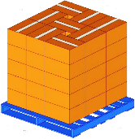
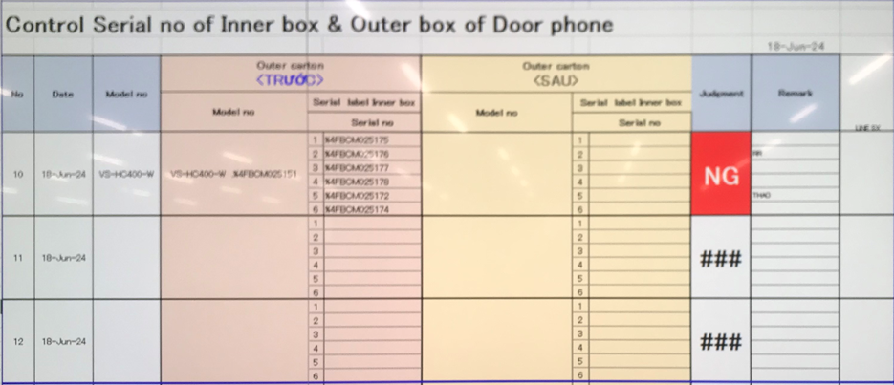
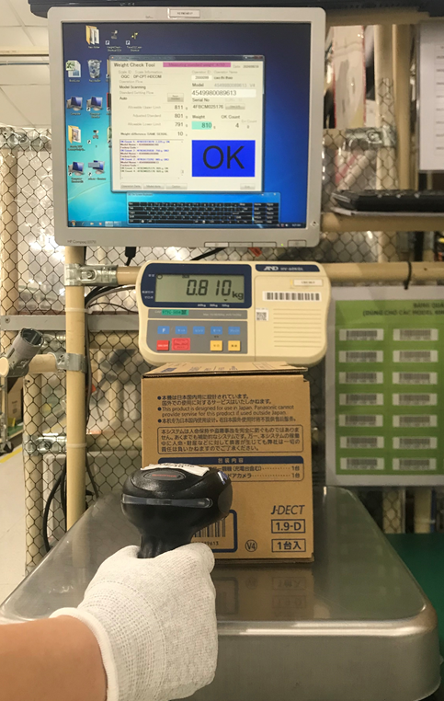
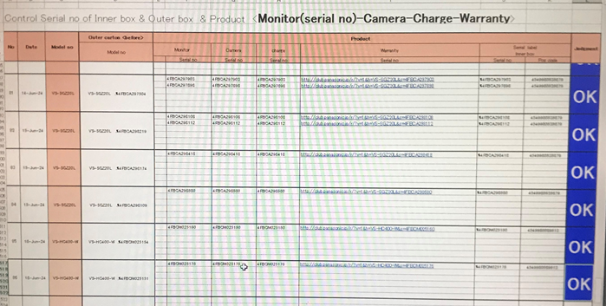
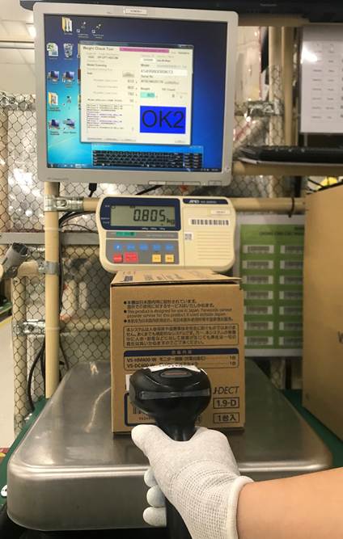
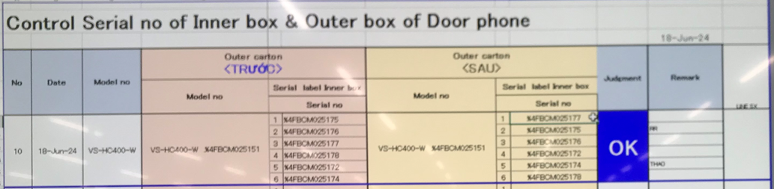




OQC DIGITAL SYSTEM
Control process sample at OQC area
Pick up sample
Reading barcode Inner/Outer excel file
Weight check 1st
OQC
inspection
Reading BC
Product/Inner excel file
Weight check 2nd
Reading barcode
Inner/Outer excel file
Return sample
No Link
2
No Link
3
4
No Link
5
6
7
8
1
No Link
Reliability
No Link
No Link
No Link
Production Line
Confirm S/N Outer & all inner boxes
Accessory control
Numbering control & Separate area
Product / Warranty/ Manual & Inner box
Accessory control
Confirm S/N Outer & all inner boxes
Warehouse FA
Improvement
Steps
1
2
3
4
5
6
7
8
Auto link weight FA
Auto link weight FA
Database server OQC
Control pick-up quantity

Slide 7

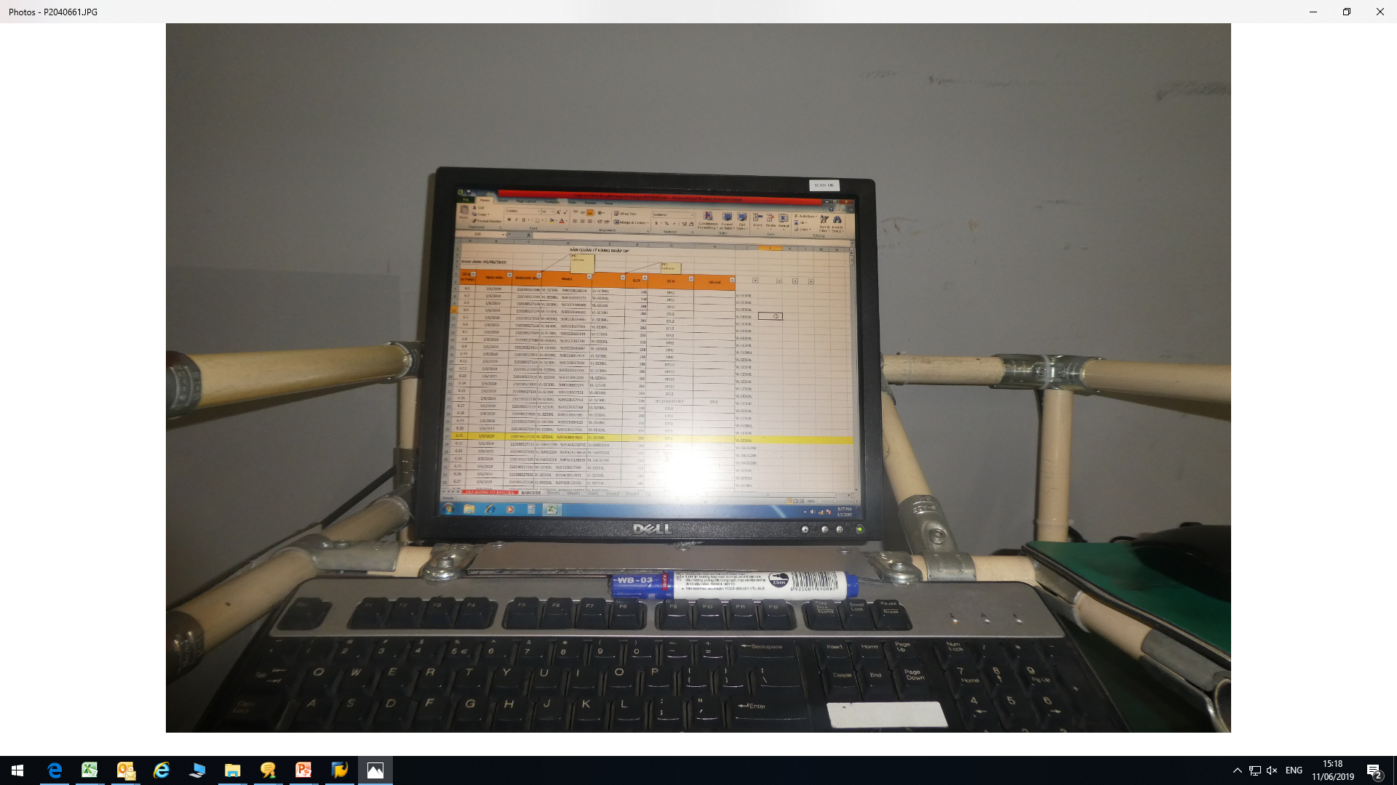

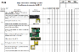
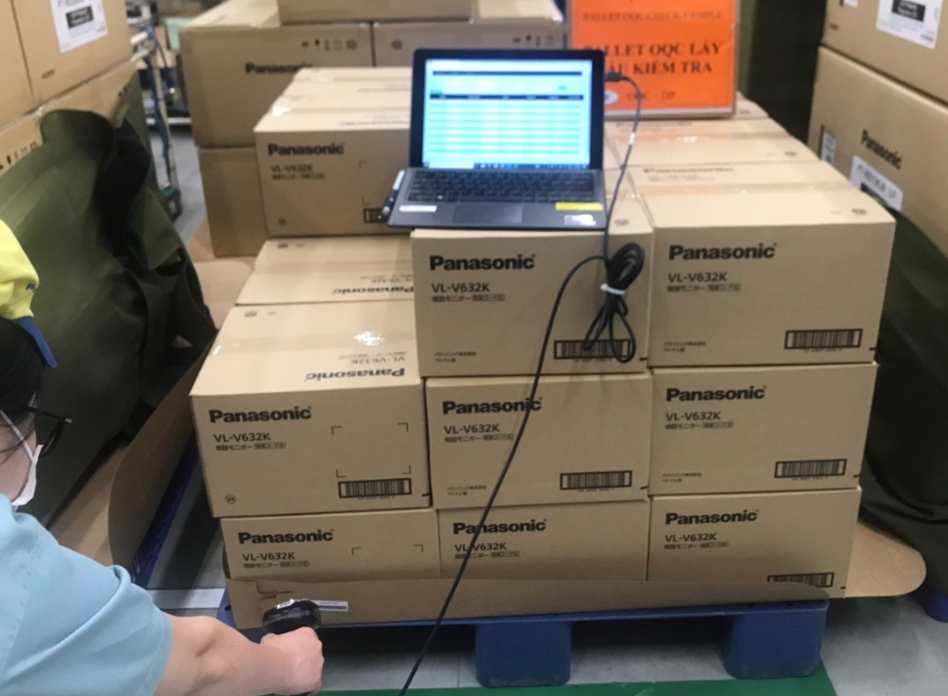




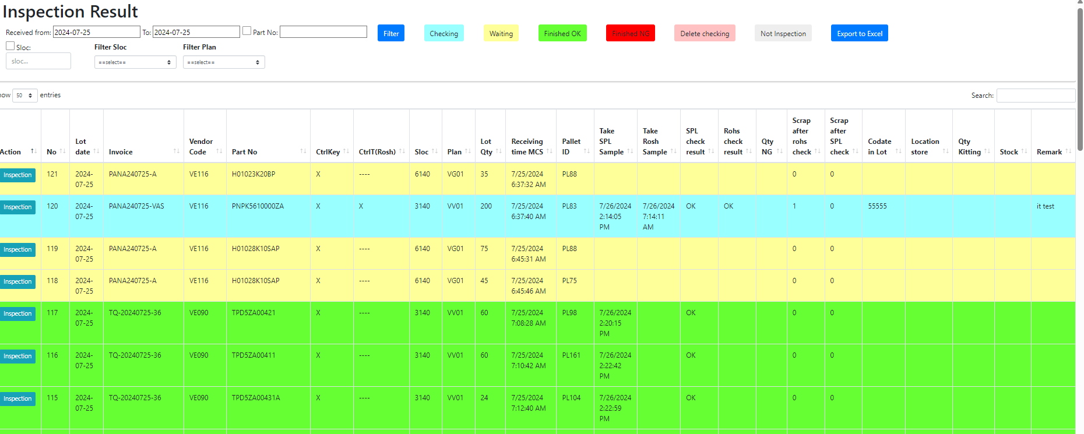
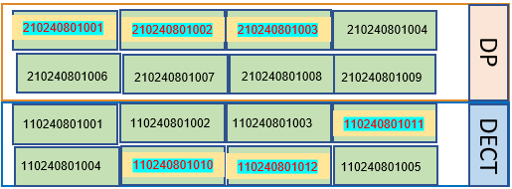


OQC DIGITAL SYSTEM
E chop for OQC inspection
Line 1A
OQC Inspection
Line 2A
Weight check 1
Scan serial outer / inner the first
OQC inspection
Scan serial outer / inner the second
Weight check 2
Input inspection result on excel file
OQC inspection result
Line 3A
OK
NG
OQC member pick up sample
Chop stamp Process
Line 4A
Recode ID Pallet & S/N carton box by excel file
Find all same model, production date, line, shift
Line 5A
OQC find Pallet ID
Matching ID Pallet and Outer Carton
OQC chop stamp all ID Pallet
OK
NG
location
OQC
Database server
Production line
Day- Month- Year
New system link FA-SCM-OQC
E – chop can
replace
Auto judgment OK for
All pallet ID the same Model, production date, line and shift.
FA
Link
OQC
Link
SCM
Shrink machine
Visualize OQC inspection
OK
OQC return sample
FA shrink pallet ID
FA fix location
Day- Month- Year
OQC
DP area
DECT area
SCM Warehouse
SCM Out location
Visualize FA Warehouse area
WMS system
Shipping To market

Slide 8
OQC DIGITAL SYSTEM
◆Before
◆ After
FA
OQC
SCM
FA
Link
OQC
Link
SCM
No indicate shipment priority
No indicate result timely
Cannot use weight system → compare S/N by manual
Update OQC result not timely.
Loss time to come to SCM for chop stamp.
Loss time to confirm stamp by visual check
Indicate result timely
Indicate shipment priority
Use weight system → auto compare S/N
Online update OQC result & Save time to come to SCM for chop stamp
No need check stamp by visual
Confirm OQC result by system
Target improve:
Prevent wrong packing leakage out to market
△ 2pax for stamp by manual
2pax
OQC Issue
Risky point : Wrong packing pass to market by control offline
Loss time to confirm production result & Shipment schedule : 90sec*150 lots=3.75H/day.
2pax/ day need to follow chop stamp in warehouse.
Improvement: Link system from FA-OQC-SCM
Prevent wrong packing.
Save time : 3.75H/day ~ 990H/year
Save manpower : △ 2pax for stamp ~ 12K$/ year

